Slide 1
High-speed Interconnection Simulation
Group member:
Yuan Yao Meng Lee
4/6/2015

Slide 2
High-speed Interconnection Simulation
Group members & Contact Information:
Yuan Yao : yaoyuan526@gmail.com
Meng Lee : mlee060@ucr.edu
Date: 4/6/2015
Notes:
J

Slide 3
Guidelines
Concept & Application
High-level block diagram
Major components
Results
Technical challenges
Summary
Notes:
J

Slide 4










Concept and Application
The concept of our project is to simulate a serial concatenated four-port channel taking into account for reference and terminal impedance.
The application of our design is practical in industrial purpose.
Y
1
2
3
4
Notes:
J: When a new channel is designed, it is important to test the channel’s functions and properties to see if it reaches the expected requirement. In this way, we use our program to simulate the channel such as this 4 port channel network in the diagram.

Slide 5
High-level design
Start
Load channel model
Load s4p touchstone file data
Concatenate s4p's
Calculate transfer function for channel
Going through AMI_init()
Channel Impulse Response
Generate data bits
Convolve with channel impulse response
send data through AMI_getwave RX
Result
Eyediagram
Send data through AMI_Getwave TX
Notes:
J

Slide 6
Major Components
Concatenate function - Meng Lee
Channel Impulse Response - Yuan Yao
Calling AMI_ functions - Together
Notes:
J : There are three major components to our design.

Slide 7
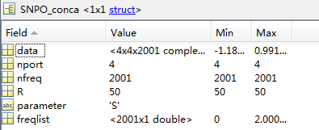
Concatenate function
Functionality: Take in two touchstone type data structure in Matlab and concatenate them.
Start
S matrix to T matrix
T matrix to S matrix
Row Swap
Interpolation
Multiply both T matrices
Notes:
Okay then we can start to talk the first major component, conc function, I wrote the concatenate function in matlab and its functionality is to ^^^^^^^^ ON the left, the diagram shows how the function works step by step. ON the right, this is an screenshotted example of a touchstone type data structure that contains : data, number of ports, number of frequencies, impedances, parameter, and the frequency list.

Slide 8
Concatenate function cont.
First the function swap rows and columns using rowswap function to achieve port numbering order of [1 3;2 4] as shown in the written figure.
snp1
snp2
3
1
1
2
2
4
3
4
snp1
snp2
1
3
1
3
2
4
2
4

Slide 9
Concatenate function cont.
After row and column swap, the function converts both SNP data structure to T matrices (TNP) using algorithms so that we can combine them by multiplying both matrices.
Then the function converts the product of the two T matrices back to S parameters.
SNP1
SNP2
TNP2
TNP1
Concatenated SNP
TNP2
TNP1

Slide 10
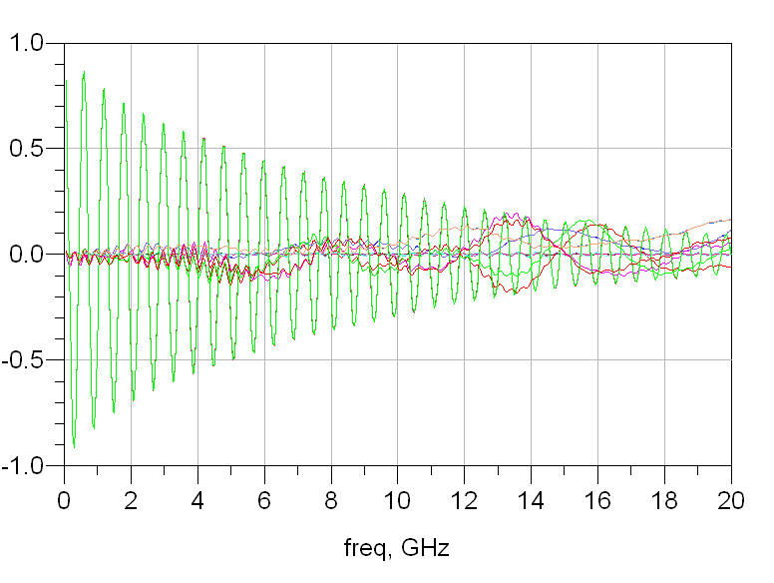
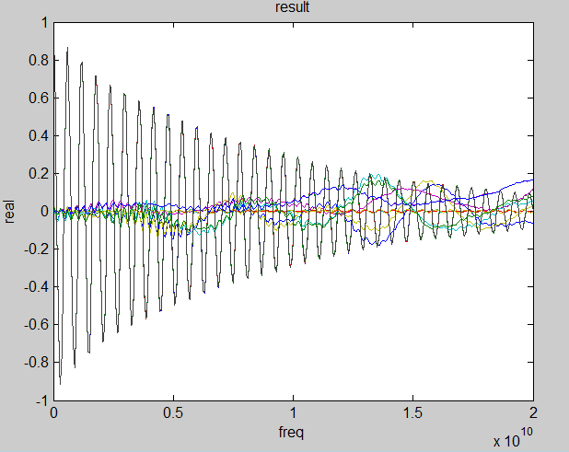
Results for concatenate functions
As we can compare matlab genrated s4p(left) is very similar to ADS results(right) with an error percentage of -1.4998% possibly due to using different frequency points.

Slide 11
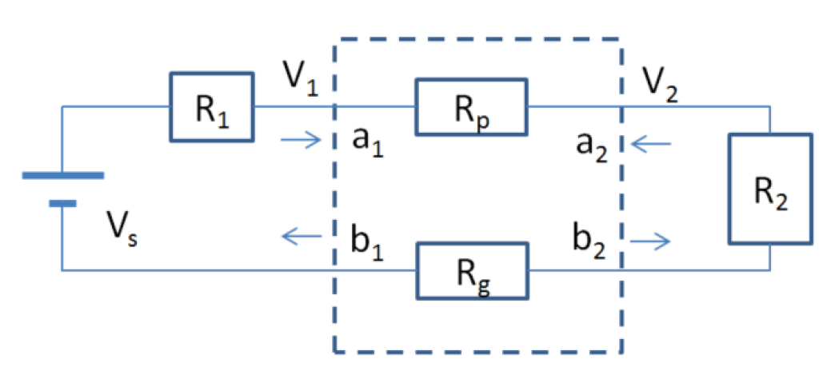
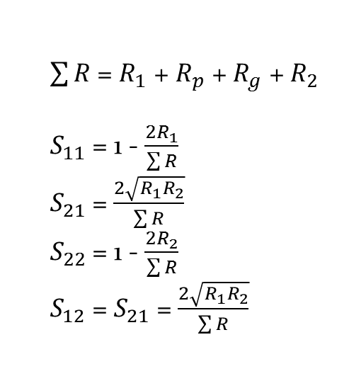
Insert DC points
$\sum{R}$ = $R_{1}$ + $R_{p}$ + $R_{g}$ + $R_{2}$
$S_{11}$ = 1 - $\frac{2R_{1}}{\sum{R}}$
$S_{21}$ = $\frac{2\sqrt{R_{1}R_{2}}}{\sum{R}}$
$S_{22}$ = 1 - $\frac{2R_{2}}{\sum{R}}$
$S_{12}$ = $S_{21}$ = $\frac{2\sqrt{R_{1}R_{2}}}{\sum{R}}$
Before concatenation, we should insert DC points to S-parameter.
Notes:
This is a two-port network. Rp and Rg are power and ground resistances at DC. Due to the lack of shunt resistances between power and ground, the Z-parameter of such a network doesn't exist. Due to this reason, we derive the S-parameter of this network directly from incident and reflected waves at DC. R1 and R2 are ${z_{0}}^{t}$ and ${z_{0}}^{r}$.

Slide 12
Deriving for channel impulse response
Y
1
2
3
4
This is the four-port network model we are using.
Notes:
As I mentioned about Z0t and Z0r from the previous slide, this is a diagram that shows you where and what kind of resistance they are.
Z0t is TX reference impedance, Z0r is RX terminal impedance.

Slide 13
Transfer function
Because Z-parameter doesn’t exit in DC point, we need to derive channel impulse response through Y-parameter after concatenate our touchstone files.
We first convert s(snp) to z(znp), then convert z(znp) to y(ynp).
Then we have I = YV;
S-parameter
Z-parameter
Y-parameter
s2z function
Inverse z
Notes:
Sparameter to z by using s2z function which is built in matlab, and then convert z parameter to y parameter by just inverting z para.

Slide 14


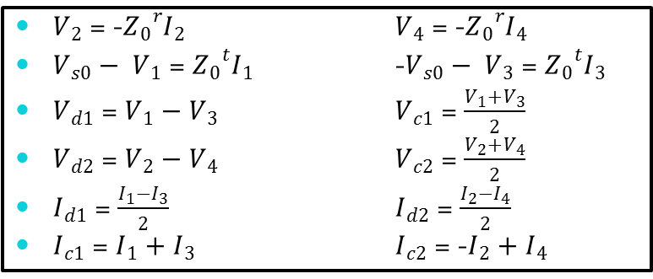








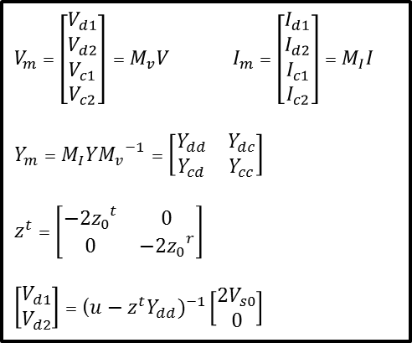
Transfer function
$$V_{s0}$$
$${Z_{0}}_{}^{t}$$
$V_{1}I_{1}$ ⇨
$$\text{⇦} V_{2}I_{2}$$
$${Z_{0}}_{}^{r}$$
Y
1
2
3
4
$${−V}_{s0}$$
$${Z_{0}}_{}^{t}$$
$V_{3}I_{3}$⇨
$$\text{⇦} V_{4}I_{4}$$
$${Z_{0}}_{}^{r}$$
$V_{m}$ = $\left[\begin{matrix}\begin{matrix}V_{d1} \\ V_{d2} \\ V_{c1} \\ V_{c2}\end{matrix}\end{matrix}\right]$ = $M_{v}V$ $I_{m}$ = $\left[\begin{matrix}\begin{matrix}I_{d1} \\ I_{d2} \\ I_{c1} \\ I_{c2}\end{matrix}\end{matrix}\right]$ = $M_{I}I$
$Y_{m}$ = $M_{I}Y{M_{v}}^{−1}$ = $\left[\begin{matrix}Y_{dd} & Y_{dc} \\ Y_{cd} & Y_{cc}\end{matrix}\right]$
$z^{t}$ = $\left[\begin{matrix}{{−2z}_{0}}^{t} & 0 \\ 0 & {{−2z}_{0}}^{r}\end{matrix}\right]$
$\left[\begin{matrix}V_{d1} \\ V_{d2}\end{matrix}\right]$ = (${u−z^{t}Y_{dd})}^{−1}\left[\begin{matrix}{2V}_{s0} \\ 0\end{matrix}\right]$
$V_{2}$ = -${Z_{0}}_{}^{r}I_{2}$ $V_{4}$ = -${Z_{0}}_{}^{r}I_{4}$
$V_{s0}− V_{1}$ = ${Z_{0}}_{}^{t}I_{1}$ -$V_{s0}− V_{3}$ = ${Z_{0}}_{}^{t}I_{3}$
$V_{d1}$ = $V_{1}−V_{3}$ $V_{c1}$ = $\frac{V_{1}+V_{3}}{2}$
$V_{d2}$ = $V_{2}−V_{4}$ $V_{c2}$ = $\frac{V_{2}+V_{4}}{2}$
$I_{d1}$ = $\frac{I_{1}−I_{3}}{2}$ $I_{d2}$ = $\frac{I_{2}−I_{4}}{2}$
$I_{c1}$ = $I_{1}+I_{3}$ $I_{c2}$ = -$I_{2}+I_{4}$
Notes:
We use the first four known terminal equations and the last eight mix-mode equations to derive our transfer function. After a series of complex derivations, we got Ym means the mix-mode Y parameter. As for now, if we take account into common mode voltages and currents, we do not have enough time to make our programs ready. Therefore, we only do the differential only case and we pick Ydd from Ym to do the rest of derivations. We finally got the input and output relation. Because Vd1 is the reference differential voltage while Vd2 is the terminal, we only need Vd2 and Vs0’s relation. In that way, we extract the second row and first column from this 2 by 2 matrix and that’s the transfer function.

Slide 15
Different cases of trans. function
Because one of our project most important part to take into account for is the reference and terminal impedance, we have 4 different cases when these resistances are different.
Below is 4 different scenarios that we have:
 | 0<ZL<inf | ZL = inf
Zs = 0 | Case 1 | Case 3
0 < Zs < inf | Case 2 | Case 4
Notes:
So each of the four cases have its own derivation. And because of time constraint of the presentation, we will not go into details on how we derive every single one of them.
Why 4 cases? And what are the equations? Because Z0t and Z0r can reach some limits, for example, when Z0t = 0, our derivation ,as you guys have seen on the previous, would be different.
We did not put all the equation up on our presentation because that would take too much space. All the equations and derivations are on our google drive for reference.

Slide 16
Inverse Fourier transform
After we got the transfer function, we need to do inverse Fourier transform to it to find the channel impulse response.
We need to make our transfer function a periodic function by mirror its whole part to the right so that after ifft our channel impulse response will not have any complex part.

Slide 17
Inverse Fourier transform
To find the corresponding time list, we derive a series of time and frequency domain relations.
fstop = fq(nfp); % in Hz
fstep = fstop / (nfp - 1); % in Hz
fspan = nfp * fstep;
tstep = 1/fspan; % in seconds
tspan = 1/fstep; % in seconds
tlist = 0:tstep:(2*nfp-2)*tstep;
Notes:
Fstop is the maximum frequency of our data. Fstep is the interval of our frequncy. Fspan is the total range of frequency of our data. Tlist is the corresponding time list of the result from ifft.

Slide 18
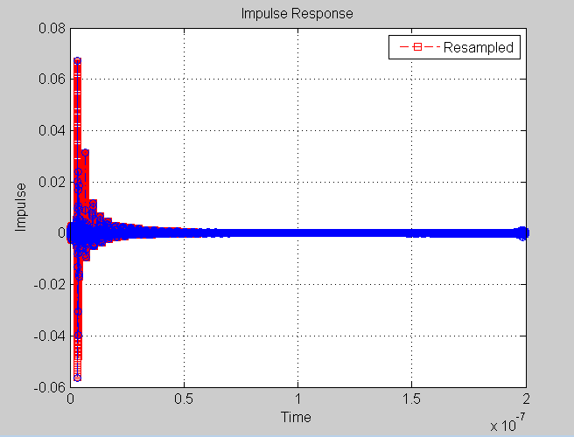
Channel impulse response result
Case 1
The blue line represents the original result from ifft. The red line represents the interpolated result corresponding to tlist.
Notes:
After we are done with these derivations, we can plot our resulting channel impulse response. The x-axis is the time. The y-axis is magnitude

Slide 19
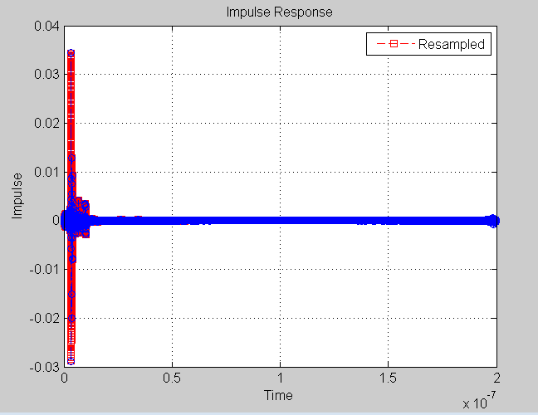
Channel impulse response result
Case 2

Slide 20
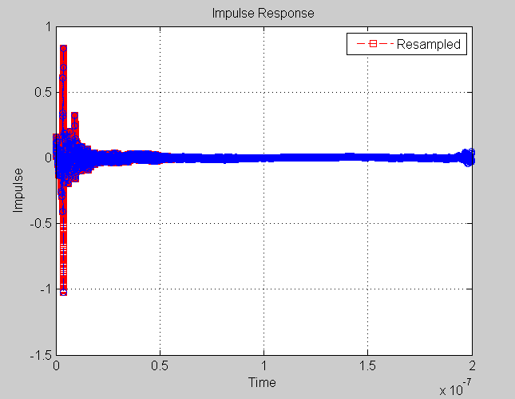
Channel impulse response result
Case 3

Slide 21
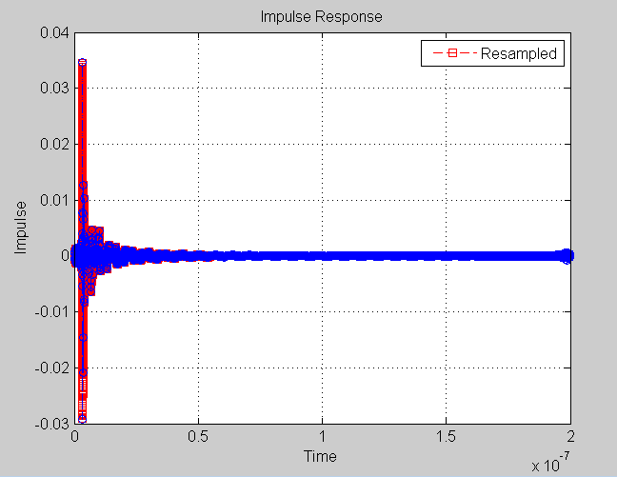
Channel impulse response result
Case 4
Notes:
As you can clearly see, All of these 4 cases are similar but different because of different derivations and impedances.

Slide 22
Reviewing block diagram
Start
Read channel model
Read s4p touchstone file data
Concatenate s4p's
Calculate transfer function for channel
Going through AMI_init()
Channel Impulse Response
Generate data bits
Convolve with channel impulse responds
send data through AMI_getwave RX
Result
eyediagram
Send data through AMI_Getwave TX

Slide 23

Calling AMI_functions
The executable model file of a Serializer-Deserializer (SERDES) transmitter or receiver contains up to three functions:
AMI_Init
AMI_GetWave
AMI_Close
The interfaces to these functions are designed to support three different phases of the simulation process:
initialization
simulation of a segment of time
termination of the simulation.
Notes:
First off, we have channel model that is in a form of .ami and .dll files, and they contain these three functions that we have to call upon.
And If you look at the diagram on the bottom right, AMI_Init basically initially the ami_functions. But actually, Yuan and I figured that the function takes in our channel impulse response and convolve with some algorithms it has within its model file to give back an optimized impulse response.
AMI_getwave is a black box using to transmit and recover our data bits
And then at the end of our simulation, we terminate using AMI_close.

Slide 24
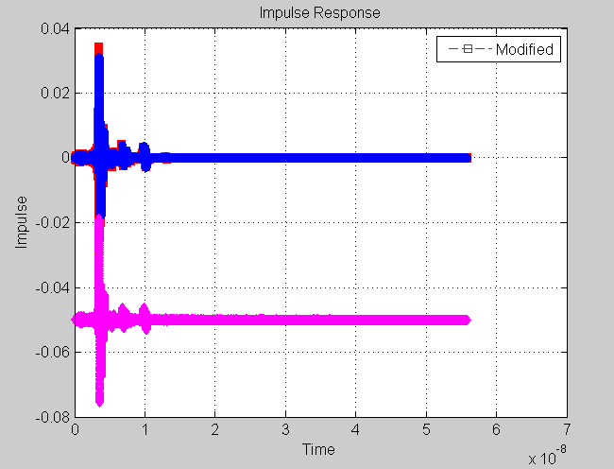
AMI_init
We first call AMI_init function. Inputting our channel impulse response, it will initialize the AMI_functions, then it will also give us am optimized impulse response from output.
Blue graph is the original channel impulse response. Pink graph is the channel impulse response after AMI_init
Notes:
There are some algorithms inside the model that AMI_init calls on, as I mentioned before, it convolved our channel impulse with these algorithms and the result is a vertical shift downward.

Slide 25
Reviewing block diagram
Start
Read channel model
Read s4p touchstone file data
Concatenate s4p's
Calculate transfer function for channel
Going through AMI_init()
Channel Impulse Response
Generate data bits
Convolve with channel impulse responds
send data through AMI_getwave RX
Result
eyediagram
Send data through AMI_Getwave TX

Slide 26
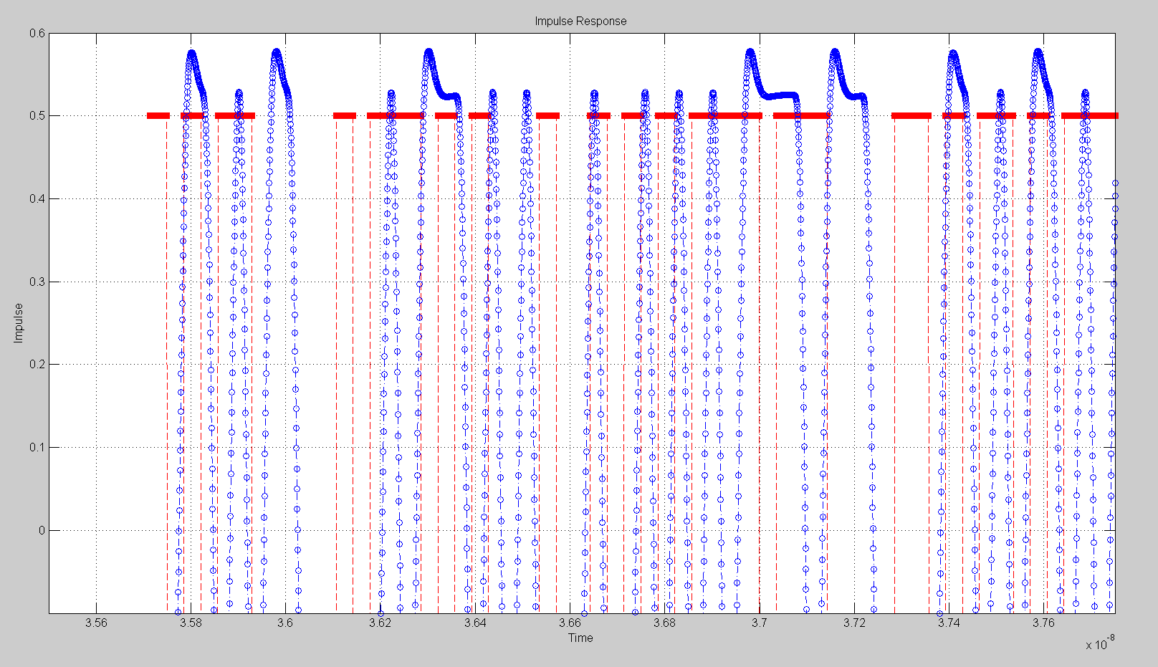
Calling AMI_functions cont.
Now we generate 10k random bits and take 64 samples for each bits which give us 640k data points using NRZ convention.
These data points are then sent through TX using AMI_getwave for TX
Below is a sample that we extracted from our data that contains 1600 samples which is 1600/64 = 25 bits.
Blue graph shows our data points after TX Red graph shows after we generated our data.

Slide 27
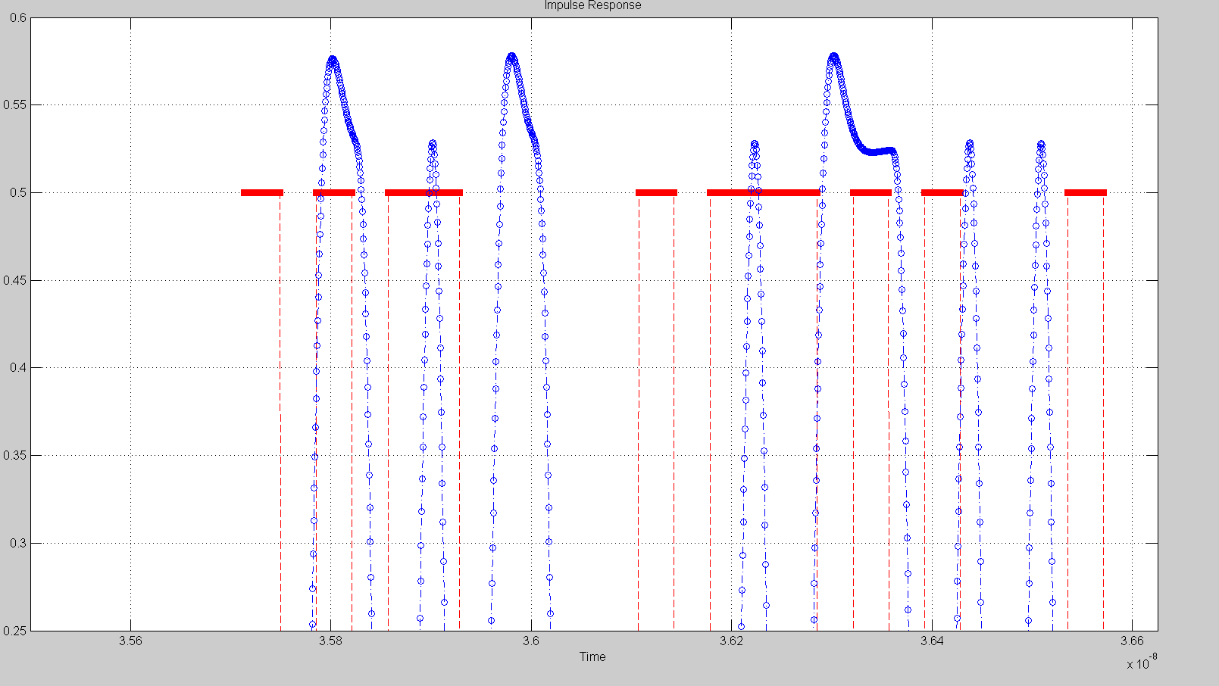
Calling AMI_functions cont.
Red is input to TX, Blue is output from TX
Notes:
Next is the more close-up graph on these data points. As you can see, output from Tx has about 0.02 ns delay from the original data points.

Slide 28
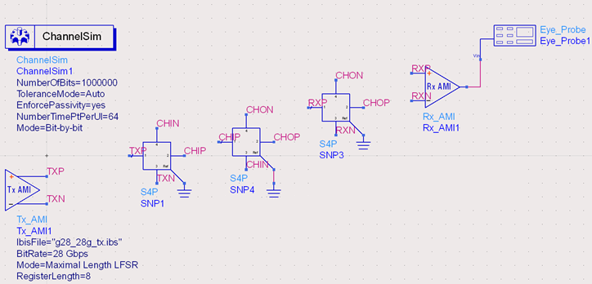
Calling AMI_functions cont.
Now the data is ready to convolve with channel impulse response that we obtained earlier.
Notes:
This picture is a screenshot of our schematics that we created from ADS software, and I am showing this to give you guys a better idea on where we are now, SO

Slide 29
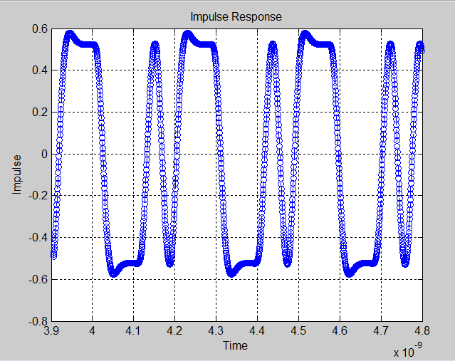
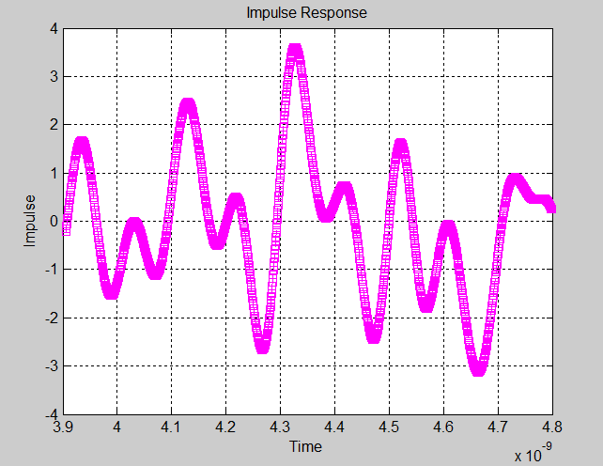
Convolution
Blue graph represents data samples after TX AMI_getwave.
Pink graph represents data samples after convolving with channel impulse response.

Slide 30
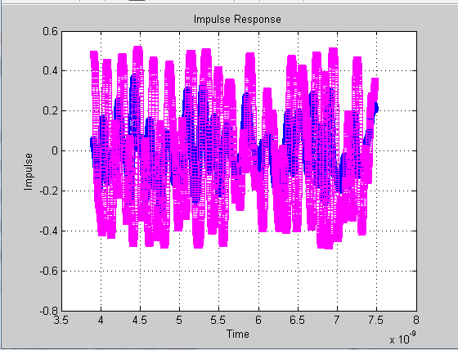
Calling AMI_functions cont.
After convolving with channel impulse response, we send our data into RX AMI_getwave in a similar fashion as TX.
Pink graph represents data samples after RX AMI_getwave.
Blue graph represents data samples at the input of RX
Notes:
As you can see, our Pink graph doesn’t behave like the way we want it to, we will discuss this very soon in later slides.

Slide 31
High-level design
Start
Read channel model
Read s4p touchstone file data
Concatenate s4p's
Calculate transfer function for channel
Going through AMI_init()
Channel Impulse Response
Generate data bits
Convolve with channel impulse responds
send data through AMI_getwave RX
Result
eyediagram
Send data through AMI_Getwave TX

Slide 32
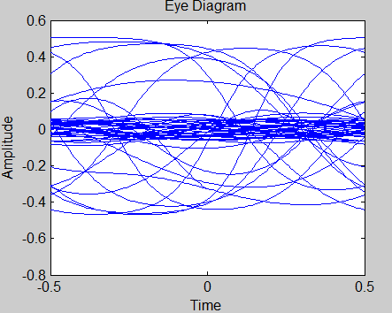
End result
After we have our samples of bits go through RX AMI_Getwave, it is ready to be plotted into eye diagram.

Slide 33
Technical difficulties
As you can see from our eye diagram, our eye is closed. There are many possible problems that may cause us to have this result.
Using mixed mode
Incorrect Algorithm of deriving transfer functions
Serdes Model error
Also, it takes a few hundred thousand to a million bits to initialize RX, Using 10k bits is not enough to set RX up.

Slide 34
Summary
Even though this is the end of our final presentation, we still have much work to do for our project with Professor Sheldon Tan and Engineering advisor James Zhou.
Also, because this technology is fairly new to the industry, we were not able to get our hands on many channel model files. So later on, as we get more models, we can better test our program.

Slide 35
Acknowledgment
Professor Shelton Tan
James Zhou, Sr. Principal Engineer, Qlogic Corporation
IBIS (I/O Buffer Information Specification) Version 5.1
Reference Google Drive: Link

